Slide 1
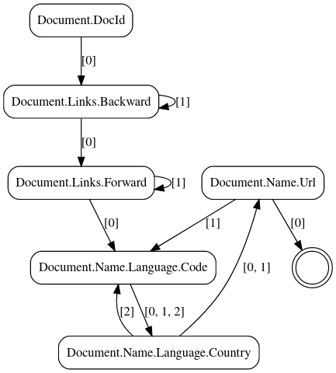
Promised last time: FSM graphs
digraph finite_state_machine {
size="8,5"
node [shape = doublecircle]; "end" [label=""];
node [shape = rect, style = rounded];
"Document.Links.Backward" -> "Document.Links.Backward" [label="[1]"];
"Document.Links.Backward" -> "Document.Links.Forward" [label="[0]"];
"Document.DocId" -> "Document.Links.Backward" [label="[0]"];
"Document.Name.Url" -> "end" [label="[0]"];
"Document.Name.Url" -> "Document.Name.Language.Code" [label="[1]"];
"Document.Name.Language.Code" -> "Document.Name.Language.Country" [label="[0, 1, 2]"];
"Document.Links.Forward" -> "Document.Name.Language.Code" [label="[0]"];
"Document.Links.Forward" -> "Document.Links.Forward" [label="[1]"];
"Document.Name.Language.Country" -> "Document.Name.Url" [label="[0, 1]"];
"Document.Name.Language.Country" -> "Document.Name.Language.Code" [label="[2]"];
}
https://dreampuf.github.io/GraphvizOnline/

Slide 2
New
Code Generation (partly)
Better data generation script
More meaningful benchmarks (see next slide)

Slide 3
Benchmarks
BM_Assembly_Generated_Dataset/64 4303 ms 4299 ms 1 23.2629MB/s 372.207k items/s
BM_Assembly_Generated_Dataset/128 2822 ms 2819 ms 1 35.4741MB/s 283.793k items/s
BM_Assembly_Generated_Dataset/256 4128 ms 4123 ms 1 24.2542MB/s 97.0169k items/s
BM_Assembly_Generated_Dataset/512 4189 ms 4184 ms 1 23.9005MB/s 47.8011k items/s
BM_Assembly_Generated_Dataset/1024 4163 ms 4158 ms 1 24.0477MB/s 24.0477k items/s
BM_Assembly_Generated_Dataset/2048 4296 ms 4291 ms 1 23.3025MB/s 11.6512k items/s
BM_Assembly_Generated_Dataset/4096 4234 ms 4229 ms 1 23.6463MB/s 5.91158k items/s

Slide 4
Benchmarks
BM_Assembly_Generated_Dataset/64 4303 ms 4299 ms 1 23.2629MB/s 372.207k items/s
BM_Assembly_Generated_Dataset/128 2822 ms 2819 ms 1 35.4741MB/s 283.793k items/s
BM_Assembly_Generated_Dataset/256 4128 ms 4123 ms 1 24.2542MB/s 97.0169k items/s
BM_Assembly_Generated_Dataset/512 4189 ms 4184 ms 1 23.9005MB/s 47.8011k items/s
BM_Assembly_Generated_Dataset/1024 4163 ms 4158 ms 1 24.0477MB/s 24.0477k items/s
BM_Assembly_Generated_Dataset/2048 4296 ms 4291 ms 1 23.3025MB/s 11.6512k items/s
BM_Assembly_Generated_Dataset/4096 4234 ms 4229 ms 1 23.6463MB/s 5.91158k items/s
In comparison (100 MiB; 1024 B record size):
Apache Drill (JSON): 3.714s
Apache Drill (Parquet): 2.856s
Dremel: 4.158s

Slide 5
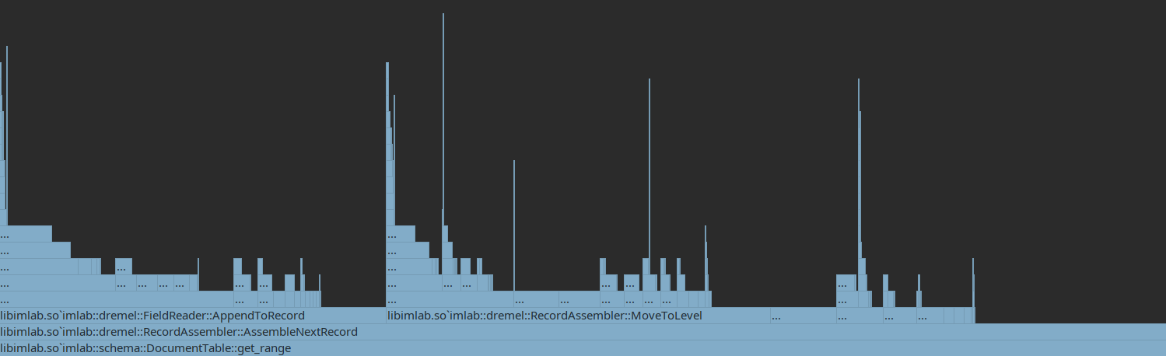
Profiling
SetString()
Inherent costs for Protobuf assembly
Protobuf costs we might be able to mitigate

